Slide 1
Harmony
Resources
Lilypad Development Team

Slide 2
Harmonizing Human Resource Management
at Critical TechWorks
1. Attendance Management:
Inconsistent attendance tracking has led to frequent errors in recording employee attendance.
Employees have been incorrectly marked as absent despite being present, causing frustration and confusion.
2. Document Handling and Requests:
HR processes have been hindered by manual handling of documents, resulting in delays in fulfilling employee requests.
Lack of a centralized platform for document management has made it difficult to track and manage various HR-related documents.
Employees often face challenges in submitting and retrieving documents, leading to inefficiencies in HR operations.
3. Training Organization:
Organizing training sessions has been a cumbersome task due to the absence of a dedicated platform for streamlined management.
HR managers struggle to coordinate training schedules, track attendance, and assess training effectiveness efficiently.
Without proper tools and systems in place, the process of planning and executing training programs has been inefficient and disjointed.

Slide 3
TABLE OF CONTENTS
01
02
Expectations
The Team
03
04
The Reasoning
Conclusion
What to expect?
Our awesome team!
Our thought process..
Some final tweaks!

Slide 4
01
Expectations
A first look into the problem

Slide 5
Risks
Technology Dependencies: There is a risk of encountering compatibility issues with existing systems, potentially delaying the implementation of functionalities.
User Adoption: Employees may resist adopting the new application, leading to low usage and decreased effectiveness of the solution and a failure to measure its effectiveness.
Scope Creep: There is a possibility of additional features or requirements being introduced throughout the project, increasing complexity and potentially extending the timeline and budget.

Slide 6
Expectations
As we embark on the journey of implementing the HR Management App at Critical TechWorks, we have outlined clear expectations regarding the outcomes we aim to achieve. By leveraging this innovative solution, we anticipate significant improvements in several key areas that are integral to our organization's success. Let's take a closer look at what we expect to accomplish through the adoption of the HR Management App.

Slide 7

Efficiency
Communication
Optimizing the training Process
We expect the HR Management App to streamline various HR processes, reducing manual effort required and saving time for both employees and HR personnel.
The team hopes that the app will facilitate smoother, better communication between employees, teams, and HR, leading to better collaboration and faster resolution of issues.
Our team expects the app to enable more efficient planning, scheduling, and tracking of employee training, resulting in better-trained employees and improved overall performance.
Employee satisfaction
Cost Saving
By reducing the time manual processes take, and reducing errors, the HR Management App is expected to lead to cost savings for the company.
Our team aims to provide a better employee experience by providing easier access to HR services and quicker responses to requests.

Slide 8
The Team
02
The Frogrammers

Slide 9


The Dev Team
Also the training team, the change management team, the quality assurance team, the support and maintenance team, the user design team, the…
Name: Hugo Guimarães
Professional Experience:
Chief Executive Juggler
Global Conglomerate Inc.
Managed a team of overachievers with a knack for multitasking.
Balanced the demands of multiple departments, projects, and personalities with finesse.
Successfully navigated the corporate jungle while juggling a dozen flaming swords (metaphorically speaking).
Director of Disruption
Disruptive Innovations Co.
Led a team of disruptors in challenging the status quo and reshaping industries.
Pioneered groundbreaking strategies that left competitors scratching their heads (and scrambling to catch up).
Embraced chaos as a catalyst for change and innovation, earning the nickname "Disruption Dynamo."
Vice President of Velocity
Velocity Ventures LLC
Drove strategic initiatives at warp speed, leaving competitors in the dust.
Accelerated growth, profitability, and market share through bold decision-making and fearless execution.
Set a new standard for velocity in the corporate world, earning accolades and admiration from peers (and a few jealous glares).
Name: Juno
Professional Experience:
Indie Game Developer Pixel Perfection Studios
Developed indie games with a team of highly caffeinated weirdos.
Mastered the art of juggling pixels, polygons, and deadlines..
Survived countless all-night coding sessions fueled by pure frustration and questionable snack choices.
Chief Chaos Officer Chaos Games Co.
Solved complex coding conundrums with a mix of ingenuity, stubbornness, and sheer luck
Inspired awe, wonder, and occasional existential crises among players worldwide.

Slide 10


The Dev Team
Also the training team, the change management team, the quality assurance team, the support and maintenance team, the user design team, the…
Name: Pedro The Fullstacker
Professional Experience:
Fullstack Wizard Code Conquerors Co.
Commanded both frontend and backend realms with equal mastery and finesse.
Developed scalable, high-performance applications that left competitors in awe (and envy).
Mastered the art of wielding languages, frameworks, and databases like a digital samurai.
Code Crusader Tech Titans Inc.
Led daring expeditions into uncharted territories of technology and innovation.
Slayed bugs, optimized performance, and rescued projects from the brink of disaster with precision and skill.
Inspired awe and admiration among colleagues with feats of coding wizardry that defied logic (and occasionally, gravity).
Name: César the enthusiast
Objective: To conquer the world with boundless enthusiasm and a zest for learning.
Professional Experience:
Intern Extraordinaire Enthusiasm Academy
Embraced every task with unbridled enthusiasm and a can-do attitude.
Absorbed knowledge like a sponge and turned every challenge into an opportunity for growth.
Made coffee runs, photocopied documents, and performed other intern duties with unparalleled enthusiasm (and a smile).
Junior Juggler Enthusiasm Enterprises
Jumped headfirst into various projects and initiatives with boundless energy and enthusiasm.
Assisted senior team members with tasks ranging from data entry to brainstorming sessions.
Brought a fresh perspective and a contagious enthusiasm to the team, earning the nickname "Enthusiasm Dynamo."

Slide 11

The Project Manager
Also part of the training team, the change management team, the quality assurance team, the support and maintenance team, the user design team, the…
Name: João the manager
Professional Experience:
Project Maestro Chaos Conquerors Ltd.
Orchestrated complex projects with the precision of a maestro conducting a symphony.
Directed teams with grace and finesse, navigating obstacles and challenges with ease.
Delivered projects on time, within budget, and to the highest standards of quality, earning the admiration (and envy) of peers.
Chief Chaos Coordinator Organized Outcomes Inc.
Led teams in conquering the chaos of project management with unparalleled organization and enthusiasm.
Implemented systems and processes that streamlined workflows and boosted productivity.
Mastered the art of juggling multiple projects, deadlines, and stakeholders without breaking a sweat (or losing her sanity).

Slide 12
The Reasoning
03
An App Overview

Slide 13
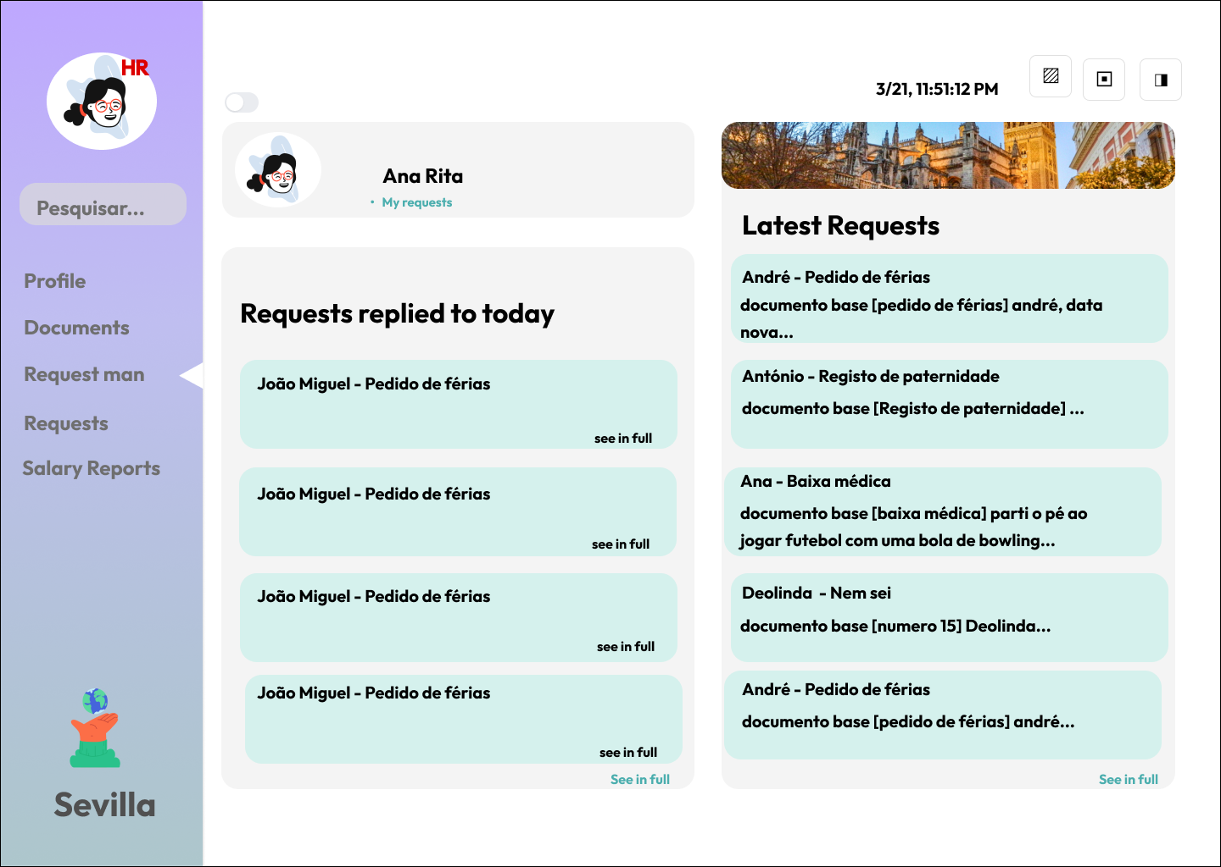
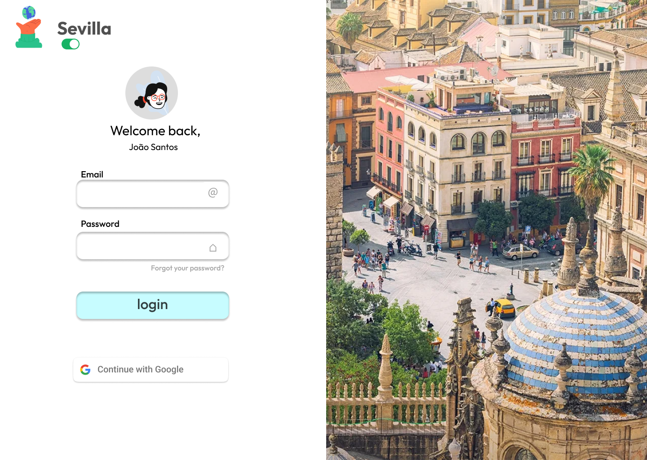
Harmony Resources App Mockups

Slide 14

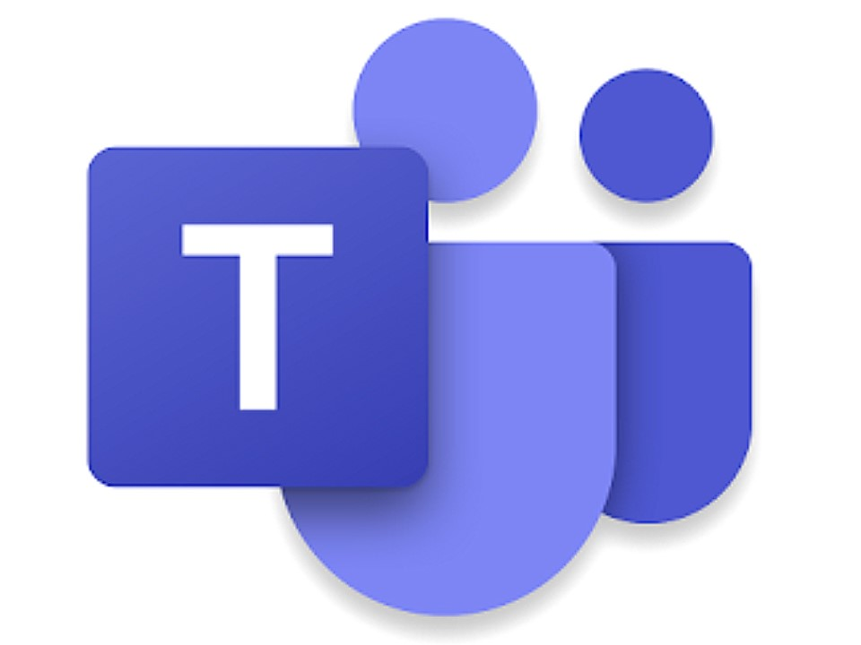
Communication channels

Slide 15
Schedule
05/29/2024: Software Prototype Delivery.
09/25/2024: Presentation of progress in meeting with clients.
02/02/2025: Application Launch.
06/20/2025: Meeting with clients, analysis of employee adaptation to the new system.
08/20/2025: Meeting with clients to tweak final details for final version of product.
5/10/2026: Final product launch.

Slide 16
Q&A Section

Slide 17
Harmonizing Human Resource Management
at Critical TechWorks
1. Attendance Management:
Inconsistent attendance tracking has led to frequent errors in recording employee attendance.
Employees have been incorrectly marked as absent despite being present, causing frustration and confusion.
2. Document Handling and Requests:
HR processes have been hindered by manual handling of documents, resulting in delays in fulfilling employee requests.
Lack of a centralized platform for document management has made it difficult to track and manage various HR-related documents.
Employees often face challenges in submitting and retrieving documents, leading to inefficiencies in HR operations.
3. Training Organization:
Organizing training sessions has been a cumbersome task due to the absence of a dedicated platform for streamlined management.
HR managers struggle to coordinate training schedules, track attendance, and assess training effectiveness efficiently.
Without proper tools and systems in place, the process of planning and executing training programs has been inefficient and disjointed.

Slide 18
TABLE OF CONTENTS
01
02
Expectations
The Team
03
04
The Reasoning
Conclusion
What to expect?
Our awesome team!
Our thought process..
Some final tweaks!

Slide 19
01
Expectations
A first look into the problem

Slide 20
Risks
Technology Dependencies: There is a risk of encountering compatibility issues with existing systems, potentially delaying the implementation of functionalities.
User Adoption: Employees may resist adopting the new application, leading to low usage and decreased effectiveness of the solution and a failure to measure its effectiveness.
Scope Creep: There is a possibility of additional features or requirements being introduced throughout the project, increasing complexity and potentially extending the timeline and budget.

Slide 21
Expectations
As we embark on the journey of implementing the HR Management App at Critical TechWorks, we have outlined clear expectations regarding the outcomes we aim to achieve. By leveraging this innovative solution, we anticipate significant improvements in several key areas that are integral to our organization's success. Let's take a closer look at what we expect to accomplish through the adoption of the HR Management App.

Slide 22
Efficiency
Communication
Optimizing the training Process
We expect the HR Management App to streamline various HR processes, reducing manual effort required and saving time for both employees and HR personnel.
The team hopes that the app will facilitate smoother, better communication between employees, teams, and HR, leading to better collaboration and faster resolution of issues.
Our team expects the app to enable more efficient planning, scheduling, and tracking of employee training, resulting in better-trained employees and improved overall performance.
Employee satisfaction
Cost Saving
By reducing the time manual processes take, and reducing errors, the HR Management App is expected to lead to cost savings for the company.
Our team aims to provide a better employee experience by providing easier access to HR services and quicker responses to requests.

Slide 23
The Team
02
The Frogrammers

Slide 24
The Dev Team
Also the training team, the change management team, the quality assurance team, the support and maintenance team, the user design team, the…
Name: Hugo Guimarães
Professional Experience:
Chief Executive Juggler
Global Conglomerate Inc.
Managed a team of overachievers with a knack for multitasking.
Balanced the demands of multiple departments, projects, and personalities with finesse.
Successfully navigated the corporate jungle while juggling a dozen flaming swords (metaphorically speaking).
Director of Disruption
Disruptive Innovations Co.
Led a team of disruptors in challenging the status quo and reshaping industries.
Pioneered groundbreaking strategies that left competitors scratching their heads (and scrambling to catch up).
Embraced chaos as a catalyst for change and innovation, earning the nickname "Disruption Dynamo."
Vice President of Velocity
Velocity Ventures LLC
Drove strategic initiatives at warp speed, leaving competitors in the dust.
Accelerated growth, profitability, and market share through bold decision-making and fearless execution.
Set a new standard for velocity in the corporate world, earning accolades and admiration from peers (and a few jealous glares).
Name: Juno
Professional Experience:
Indie Game Developer Pixel Perfection Studios
Developed indie games with a team of highly caffeinated weirdos.
Mastered the art of juggling pixels, polygons, and deadlines..
Survived countless all-night coding sessions fueled by pure frustration and questionable snack choices.
Chief Chaos Officer Chaos Games Co.
Solved complex coding conundrums with a mix of ingenuity, stubbornness, and sheer luck
Inspired awe, wonder, and occasional existential crises among players worldwide.

Slide 25
The Dev Team
Also the training team, the change management team, the quality assurance team, the support and maintenance team, the user design team, the…
Name: Pedro The Fullstacker
Professional Experience:
Fullstack Wizard Code Conquerors Co.
Commanded both frontend and backend realms with equal mastery and finesse.
Developed scalable, high-performance applications that left competitors in awe (and envy).
Mastered the art of wielding languages, frameworks, and databases like a digital samurai.
Code Crusader Tech Titans Inc.
Led daring expeditions into uncharted territories of technology and innovation.
Slayed bugs, optimized performance, and rescued projects from the brink of disaster with precision and skill.
Inspired awe and admiration among colleagues with feats of coding wizardry that defied logic (and occasionally, gravity).
Name: César the enthusiast
Objective: To conquer the world with boundless enthusiasm and a zest for learning.
Professional Experience:
Intern Extraordinaire Enthusiasm Academy
Embraced every task with unbridled enthusiasm and a can-do attitude.
Absorbed knowledge like a sponge and turned every challenge into an opportunity for growth.
Made coffee runs, photocopied documents, and performed other intern duties with unparalleled enthusiasm (and a smile).
Junior Juggler Enthusiasm Enterprises
Jumped headfirst into various projects and initiatives with boundless energy and enthusiasm.
Assisted senior team members with tasks ranging from data entry to brainstorming sessions.
Brought a fresh perspective and a contagious enthusiasm to the team, earning the nickname "Enthusiasm Dynamo."

Slide 26
The Project Manager
Also part of the training team, the change management team, the quality assurance team, the support and maintenance team, the user design team, the…
Name: João the manager
Professional Experience:
Project Maestro Chaos Conquerors Ltd.
Orchestrated complex projects with the precision of a maestro conducting a symphony.
Directed teams with grace and finesse, navigating obstacles and challenges with ease.
Delivered projects on time, within budget, and to the highest standards of quality, earning the admiration (and envy) of peers.
Chief Chaos Coordinator Organized Outcomes Inc.
Led teams in conquering the chaos of project management with unparalleled organization and enthusiasm.
Implemented systems and processes that streamlined workflows and boosted productivity.
Mastered the art of juggling multiple projects, deadlines, and stakeholders without breaking a sweat (or losing her sanity).

Slide 27
The Reasoning
03
An App Overview

Slide 28
Harmony Resources App Mockups

Slide 29
Communication channels

Slide 30
Schedule
05/29/2024: Software Prototype Delivery.
09/25/2024: Presentation of progress in meeting with clients.
02/02/2025: Application Launch.
06/20/2025: Meeting with clients, analysis of employee adaptation to the new system.
08/20/2025: Meeting with clients to tweak final details for final version of product.
5/10/2026: Final product launch.

Slide 31
Q&A Section

